Slide 1
INFX 504 The ASCII Table
By
Bob Larson

Slide 2
Topics
Original ASCII Table (7-bit)
ASCII Table Background
Newer Extended ASCII Tables

Slide 3
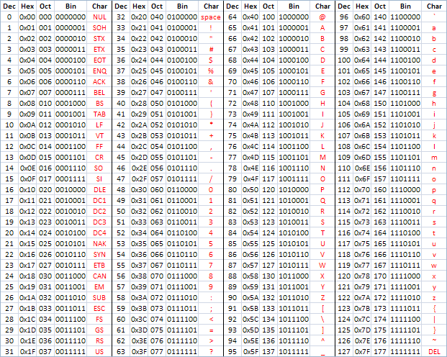
Original ASCII Table (7-bit)
American Standard Code for Information Interchange
Original: 7-bit character code
Each value represents a unique character
128 characters
0-31 Control Characters
Unprintable – control peripherals
32-127 printable characters
Printable – keyboard characters
Letters, digits, punctuation marks
Extended: 8-bits
256 characters (ISO 8859-1)
Original ASCII characters plus
128 symbols and Latin characters

Slide 4
ASCII Table Background
Developed from telegraph code
First commercial use: 7-bit teleprinter code (Bell data services)
ASCII standard: ANSI committee formed October 6, 1960
Published in 1963
Major revision in 1967
Most recent update in 1986
Originally based on the English alphabet
7-BITS encodes 128 characters
June 1992 Internet Assigned Numbers Authority (IANA) create RFC
Encourages using name "US-ASCII" for Internet uses of ASCII
Source: Wikipedia ASCII

Slide 5
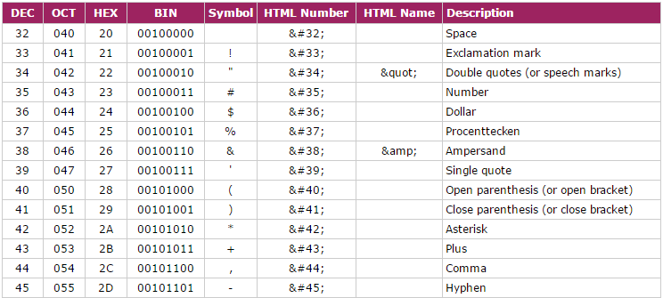
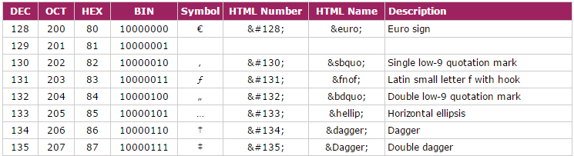
Newer Extended ASCII Tables
8-Bit Version
Original ASCII (7-bit)
128 Symbols & Latin
Add HTML number & Name
Source: http://www.ascii-code.com/

Slide 6
Fin…

